Slide 1
Mood Prediction with Facial Expression Recognition
SDL: Machine Learning with Python (CS-307L)

Slide 2
Group Members
Shashank Attarde (T204054)
Aditi Pandey (T204046)
Sudhanshu Shekhar (T208037)
Shivam Singh (T204035)

Slide 3
Contents
Aim and Objectives
Algorithms Used
Dataset Description
Implementation
Results and Analysis
Conclusion and Future Work
References

Slide 4
Aim and Objectives

Slide 5
Aim
To predict the mood of a person by recognizing their facial features

Slide 6
Objectives
Create a model that uses OpenCV’s Frontal-Face Haar Cascade Classifier to detect and extract faces from images/videos
Train a Convolutional Neural Network on the FER-2013 Dataset that takes in a Grayscale Face Image as input and outputs the predicted mood of the face.
Create a video interface for real-time prediction.

Slide 7
Algorithms Used

Slide 8
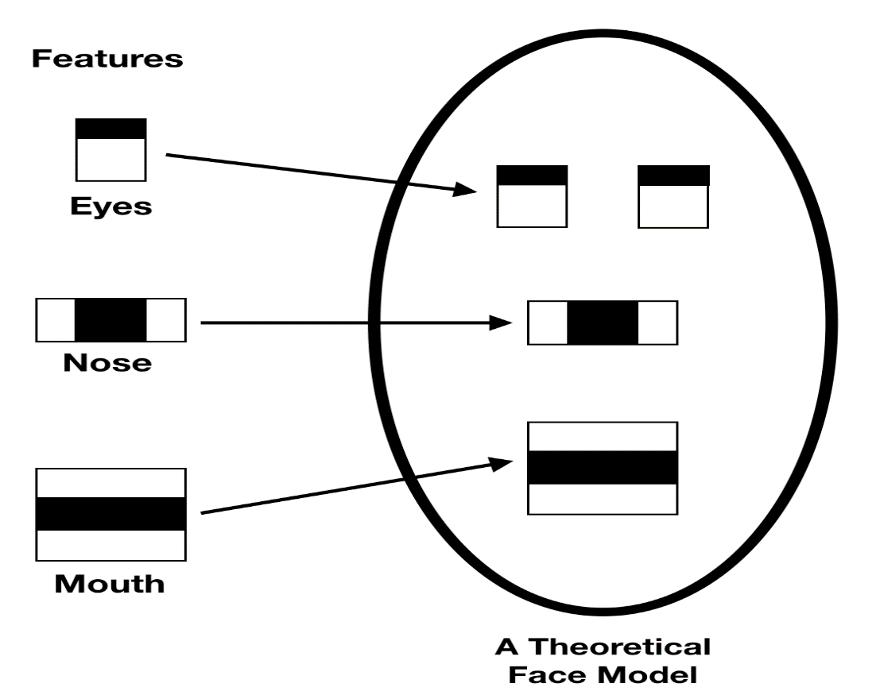
Haar Cascade Classifier
Based on the Haar Wavelet Technique to analyze pixels in an Image.
Uses a Multitude of Haar Features (Similar to CNN Kernels) to detect presence of certain features.
Uses an algorithm called AdaBoost for selecting useful Haar Features, given relevant data.
We use OpenCV’s pretrained Frontal-Face HCC for our implementation.

Slide 9

Convolutional Neural Networks
Type of Neural Networks used widely for Classification and Regression tasks involving Images as Input data.

Slide 10
Convolutional Neural Networks
Consist of a dual section pipeline, Convolution Layers and Dense Layers.
Convolution Layers are mainly concerned with Feature Extraction and Downsampling the input.
The subsequent Dense layers take the extracted features as input and perform Classification/Regression.
Use Backpropagation to learn the parameters.

Slide 11
Dataset (FER-2013)
https://www.kaggle.com/deadskull7/fer2013

Slide 12
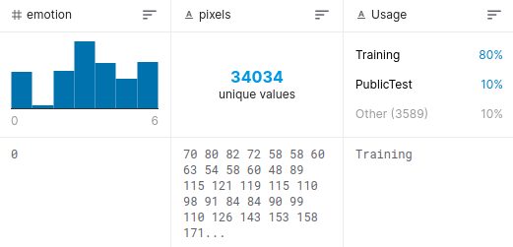
Description
Contains 34,034 Unique Instances
Seven Emotion Classes
Anger
Disgust
Fear
Happiness
Sadness
Surprise
Neutral

Slide 13
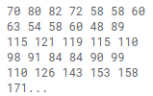
Preprocessing
The Images in the dataset are represented in linear strings of their pixel intensities, separated by spaces
We need to convert these strings into images
The string was split into an array, the numbers were converted to integers, the array was reshaped to 48x48 and the OpenCV ‘imwrite’ function was used to convert the array to an image and save it.

Slide 14
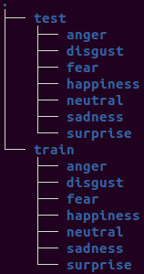
Preprocessing
Images were separated based on whether they were train or test images and further based on their class.
This is the configuration required for Keras’ ImageDataGenerator class which is used to feed images to the model while training.

Slide 15
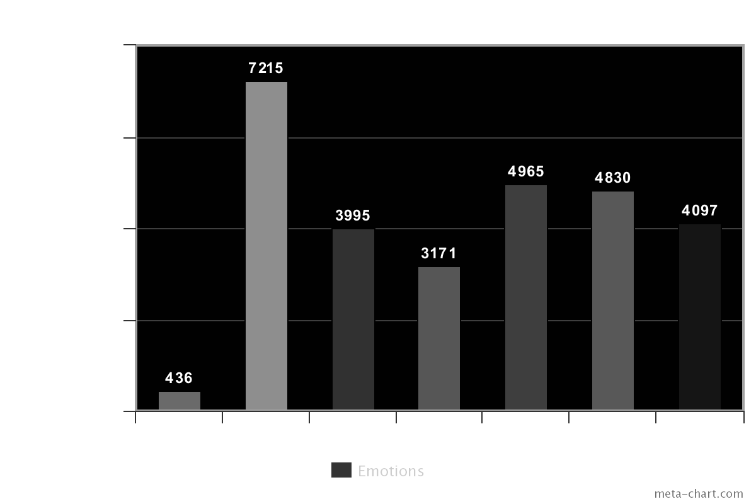

Training and Test Data Distribution

Slide 16
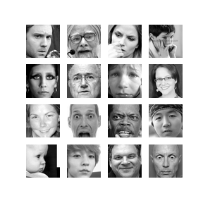
Feature Vector
The Feature Vector used for a unit instance is a 2 Dimensional 48x48 array of Grayscale Pixel Intensities of the instance image.

Slide 17
Implementation

Slide 18
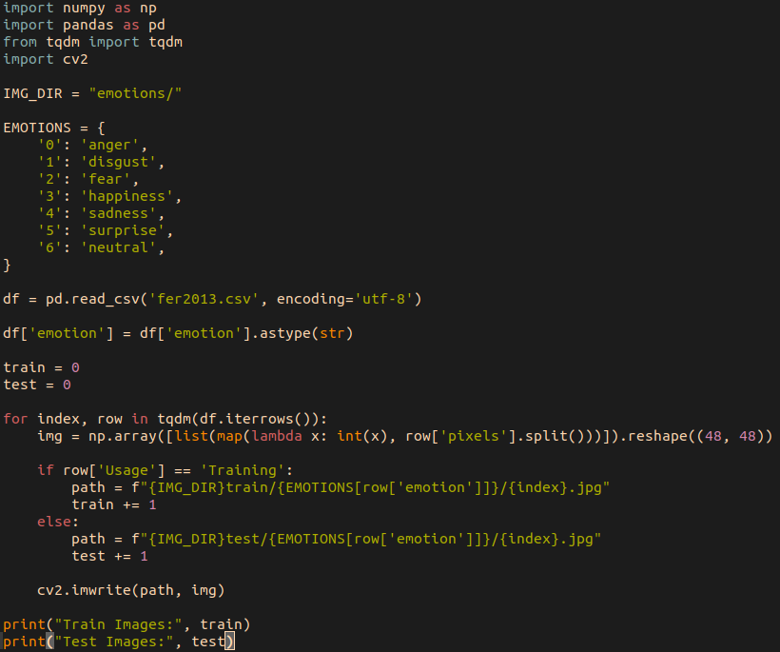
Preprocessing

Slide 19
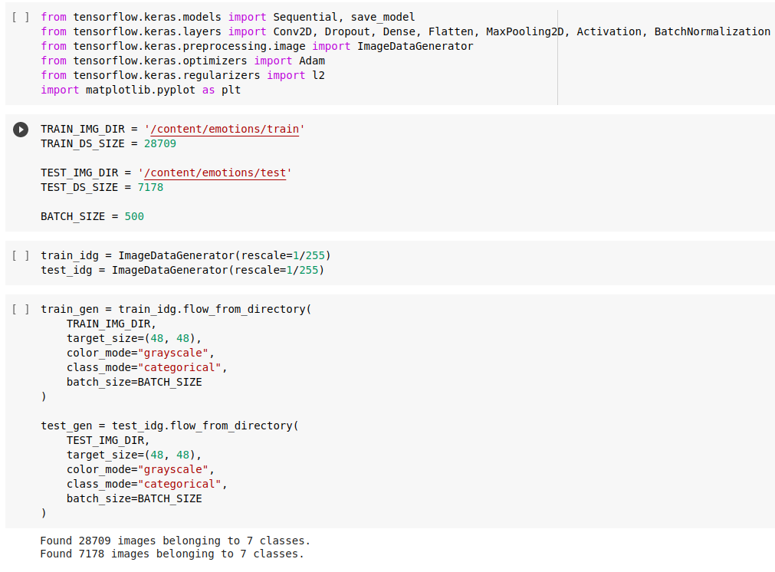
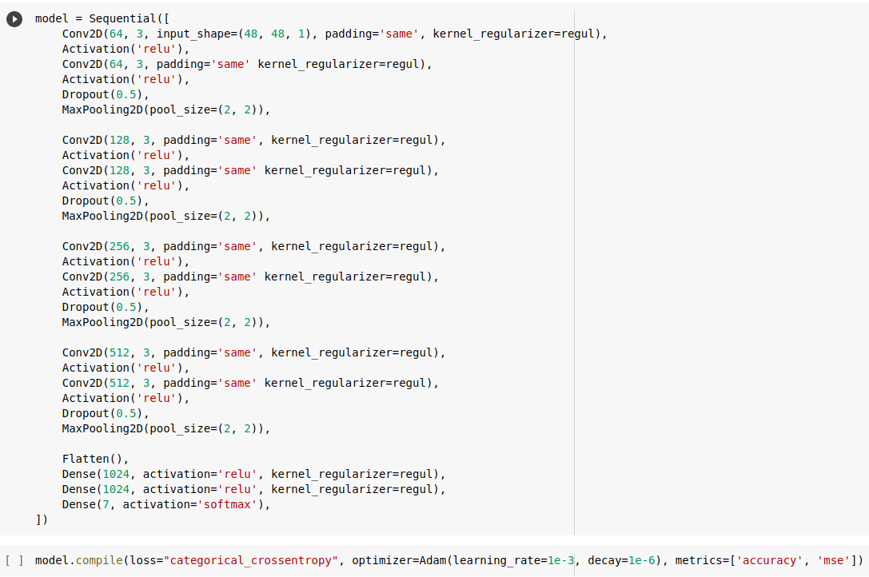
Model Assembly

Slide 20
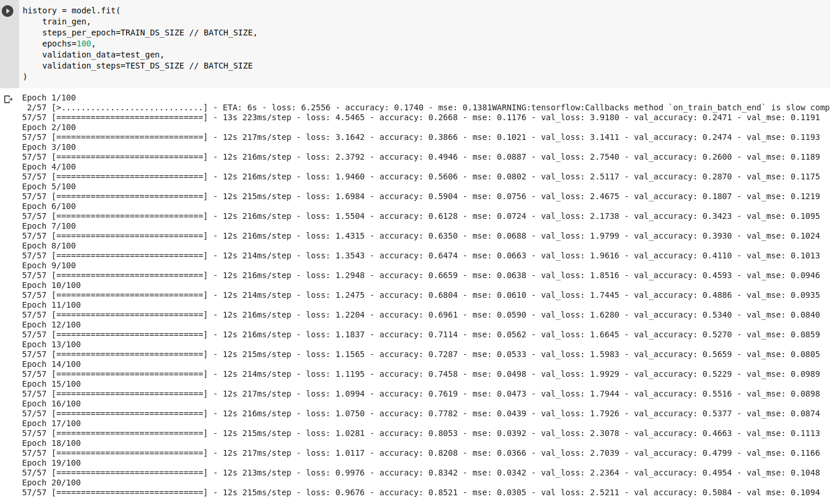
Model Training

Slide 21
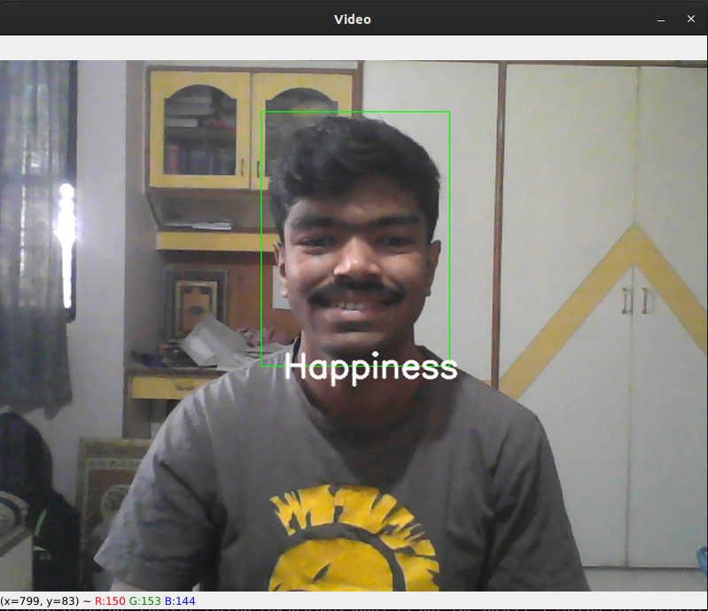
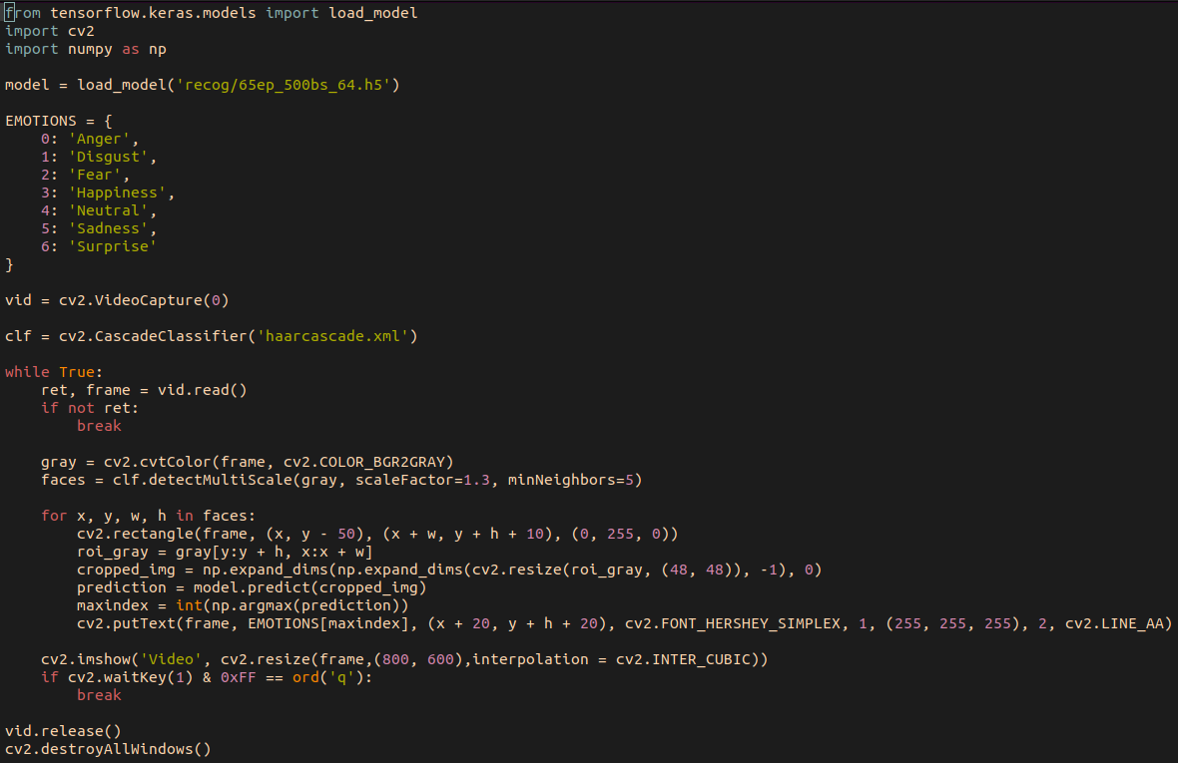
GUI

Slide 22
Results and Analysis

Slide 23
Training
A neural architecture inspired from the VGG16 architecture was used to train the model.
The model was trained for 65 epochs which is when the Validation Accuracy reached its threshold.
Initial training sessions capped out the Validation accuracy at 58%
L2 Regularization and Dropout was used to enhance the accuracy to 64%

Slide 24
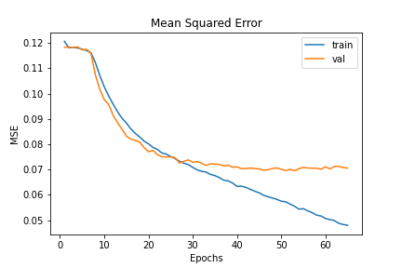
Mean Squared Error vs Epochs

Slide 25
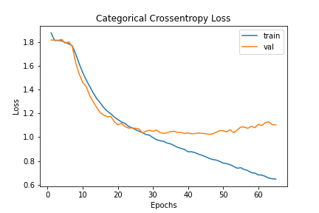
Softmax Error vs Epochs

Slide 26
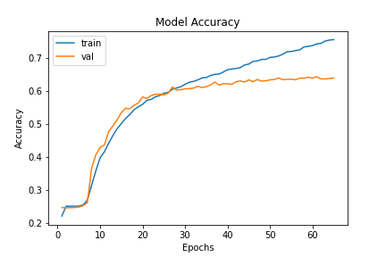
Model Accuracy vs Epochs

Slide 27
Further Training Information and Analysis
In one training session, Batch Normalization was used instead of Dropout, and in another, both were used.
The models trained in both sessions performed much poorly (only 55% validation accuracy) than the one trained with L2 Regularization and Dropout
We suspect that the combination of L2 Regularization and Dropout may be providing some positive reinforcement to the model besides preventing overfitting on training data.

Slide 28

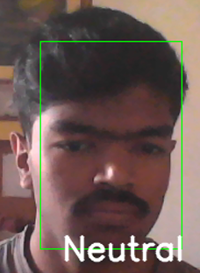

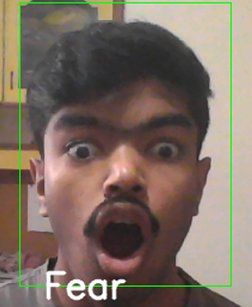
Model Result in GUI

Slide 29
Conclusion and Future Work

Slide 30
Conclusion and Future Work
This project is a good demonstration of the difficulty one incurs when trying to perform Machine Learning tasks involving Face Detection and FER
New ways of Improving FD and FER are being researched everyday. New Data gets compiled everyday
Novel methods being researched may prove to be quite detrimental to the success of FD and FER in the future.

Slide 31
References
K. Etemad, R. Chellappa, Discriminant Analysis for Recognition of Human Face Images, Journal of the Optical Society of America A, Vol. 14, No. 8, August 1997, pp. 1724-1733
C. Liu, H. Wechsler, Face Recognition Using Evolutionary Pursuit, Proc. of the Fifth European Conference on Computer Vision, ECCV'98, Vol II, 02-06 June 1998, Freiburg, Germany, pp. 596-612
L. Wiskott, J.-M. Fellous, N. Krueuger, C. von der Malsburg, Face Recognition by Elastic Bunch Graph Matching, Chapter 11 in Intelligent Biometric Techniques in Fingerprint and Face Recognition, eds. L.C. Jain et al., CRC Press, 1999, pp. 355-396
A. Bronstein, M. Bronstein, R. Kimmel, and A. Spira. 3D face recognition without facial surface reconstruction, in Proceedings of ECCV 2004, Prague, Czech Republic, May 11-14, 2004
(A Full list of references can be viewed in the report…)

Slide 32
Thank You!

